Slide 1
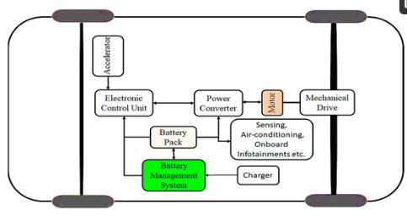
Battery Management Systems Functions
Monitoring
Protection
Charging and Discharging Management
Communication
Diagnosis
Data Management

Slide 2
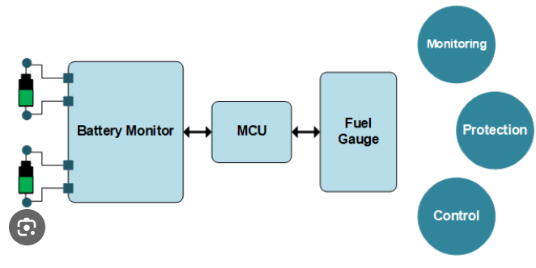
Battery Management Systems Functions
1. Monitoring
Monitoring battery pack voltage, current, cell voltage,temperature, isolation etc
Overvoltage and Overcurrent
Isolation of central Battery System
Temperature Control

Slide 3
Battery Management Systems Functions
2. Protection
protection against any battery system hazards
detecting the operating mode, setting fault criteria
Protection from external events

Slide 4
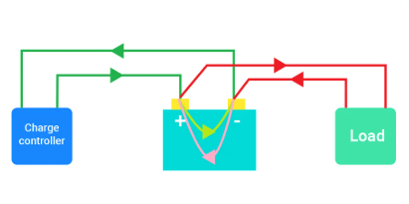
Battery Management Systems Functions
3. Charging and Discharging Management
state of charge (SOC)
control the charger current
turn on/off active switches between the pack and load/charger
conduct active and passive balancing

Slide 5
Battery Management Systems Functions
4. Communications
between internal and external BMS
BMS and the primary system
For the change in working strategy according to the
battery's performance

Slide 6
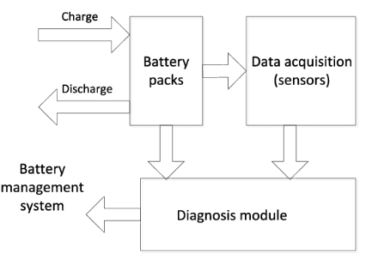
Battery Management Systems Functions
5. Diagnosis
Prediction of Depth of Discharge (DOD)
State of Charge (SOC)
Remaining Useful Life (RUL)
Available Energy, Charging Time
Detection of any faults

